Slide 1
Software Training Session- Week 2
Workspace,Packages,Nodes, Topics and Messages

Slide 2
Workspace
In ROS 2, a workspace is a directory where you organize your robotics projects. It serves as the root directory for building, compiling, and running your robot-related software.
Workspaces are essential for maintaining a structured codebase, enabling efficient code reuse, and simplifying the build process.
ROS 2 primarily uses colcon (CMake-based build tool) for managing workspaces, compiling packages, and handling dependencies.
It's important to source your workspace setup file in each terminal session to make your ROS 2 packages accessible.

Slide 3
DEMO

Slide 4
Packages
In ROS 2, a package is a directory that contains related nodes, topics, and messages. It's the fundamental unit for organizing your robot's software.
Packages provide modularity, encapsulation, and an efficient way to manage your codebase.
Packages typically include a ‘CMakeLists.txt’ file ,’package.xml’ for package metadata, and a ‘src’ directory for your code.
Command:
ros2 pkg create --build-type ament_cmake <package_name>

Slide 5
Nodes
In ROS 2, a node is a software component that performs a specific task within the robot's system. Nodes communicate with each other by publishing and subscribing to topics, providing and consuming services, and using actions for more complex interactions. Nodes are lightweight and can be distributed across different devices in a robot system.

Slide 6
Role in Robotic Systems:
Nodes play a crucial role in distributed robotics systems. Each node is responsible for a particular function or capability, such as sensor data processing, motor control, or navigation.
Communication:
Nodes communicate with each other using the publish-subscribe model through topics or the client-server model using services. This communication allows nodes to work together seamlessly.
Decentralized Architecture:
ROS 2 follows a decentralized architecture, where multiple nodes can run independently on a robot's hardware, making it scalable and adaptable to various robotic platforms.

Slide 7
Interoperability:
ROS 2 nodes can be written in various programming languages, such as Python or C++, and they can run on different operating systems, enhancing interoperability and flexibility.
Node Graph:
Nodes can be visualized in a node graph, which helps developers understand the interactions and dependencies between nodes in a robotic system.

Slide 8
DEMO

Slide 9
Topics
Topics facilitate one-to-many communication, where nodes publish messages to a topic, and other nodes interested in that topic can subscribe to receive those messages. This mechanism enables data sharing and communication between different parts of the system.

Slide 10
Data Types:
Topics can transmit various data types, including sensor measurements, control commands, status updates, and more.
Decoupling and Flexibility:
Topics provide decoupling between nodes, enhancing system flexibility. Nodes can be added, removed, or replaced without affecting the overall system's functionality as long as they adhere to the defined topics and message types.
Publish-Subscribe Model:
Topics follow the publish-subscribe model, where nodes don't need to know about each other explicitly. Instead, nodes publish data to a named topic, and any node that subscribes to that topic will receive the data.

Slide 11
DEMO

Slide 12
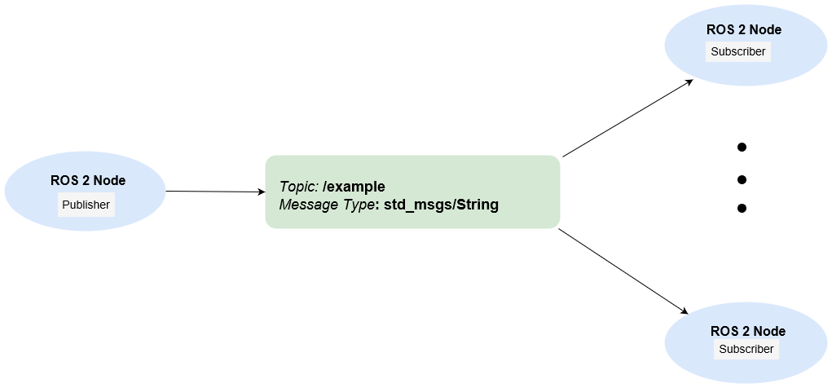
Messages
Messages specify the type and structure of data being transmitted over topics. They ensure that nodes can understand and interpret the data correctly, promoting interoperability in heterogeneous robotic systems.

Slide 13
DEMO

Slide 14
ENPM 662: Introduction to Robot Modelling
Thankyou
Presentation By Shantanu Parab
sparab@umd.edu

